Slide 1
Novel Method for breast Cancer DETECTION USING Super Pixel and LSTM_CNN Algorithm

Slide 2
ABSTRACT
In this project, we propose an automatic 3D segmentation method for transrectal ultrasound breast images, which is based on multi-atlas registration and statistical texture prior.
The atlas database includes registered breast images from previous patients and their segmented breast surfaces.
Three orthogonal Gabor filter banks are used to extract texture features from each image in the database.
Stage-specific Tumor features from the datasets are used to train (CNN-LSTM) and then to segment Using Super Pixel Segmentation the breast image from a new patient.

Slide 3
INTRODUCTION
breast cancer affects one in six women. Systematic transrectal ultrasound (breast)-guided biopsy is considered as the standard method for definitive diagnosis of breast cancer.
However, the current biopsy technique has a significant sampling error and can miss up to 30% of cancers.
We are developing a molecular image-directed, 3D ultrasound-guided biopsy system with the aim of improving cancer detection rate.
Accurate segmentation of the breast plays a key role in biopsy needle placement, treatment planning, and motion monitoring.

Slide 4
LITERATURE SURVEY
TITLE | AUTHOR | Pros | Cons | DATASET | METRICES
A Survey of Machine Learning Based Approaches for breast tumor Disease Prediction 2021 | Shubham Bind1 | Used Realtime Images | Less Accuracy | Breastcancer2018 | 75
Classifcation of blood’s disease and its stages using machine learning 2022 | John MichaelTempleton | active NIR patches are extracted | The training database consist less image | Breast tumor Kaggle | 65
Analysis and Prediction of breast Disease using Machine Learning Algorithms 2022 | Sohom Sen | Used 30 NIR Images | The system was trained with Less type of Disease. | Breast tumor Kaggle | 84
Detection of cancer Disease Using Machine Learning 2020 | G.Priyadharshini, 2T.Gowtham | High Accuracy | lowest accuracy with 40%. | NIRDATA | 90
Predicting Severity Of cancer's Disease Using Deep Learning 2020 | Srishti Grover | Dataset belonging to Multiple category | Accuracy Low | database with Disease by Name | 65

Slide 5
Segmentation Algorithm
Process of partitioning a digital image into multiple segments.
Used to find the location of lesion border.
Existing algorithms are only applicable to dermoscopy images.
Digital photographs cannot be used with existing algorithms because of illumination variation.
Segmentation based on pixel color intensity.

Slide 6
Existing System
Human based systems are involved in the breast Cancer Detection process.
But this type of systems are having reliably issues with man made error chances.
The most commonly used technique Auto encoder-Based Neural Network Algorithm is not a straightforward task due to the great variety of tumor lesions, low contrast between the lesion and the surrounding breast, irregular and fuzzy lesion borders breast types and presence of molecules.

Slide 7
PROBLEM DEFINITION
False detection.
Cannot operate on images with less amount of contrast.

Slide 8
PROPOSED Solution
The main objective of this paper is to propose a deep learning technique in combination with a convolution neural network (CNN) and long short-term memory (LSTM) with a random forest algorithm to diagnose breast cancer.
Here, CNN is used for feature extraction, and LSTM is used for extracted feature detection.
The scope of CNN_LSTM is used.
Two phases are training and testing.

Slide 9
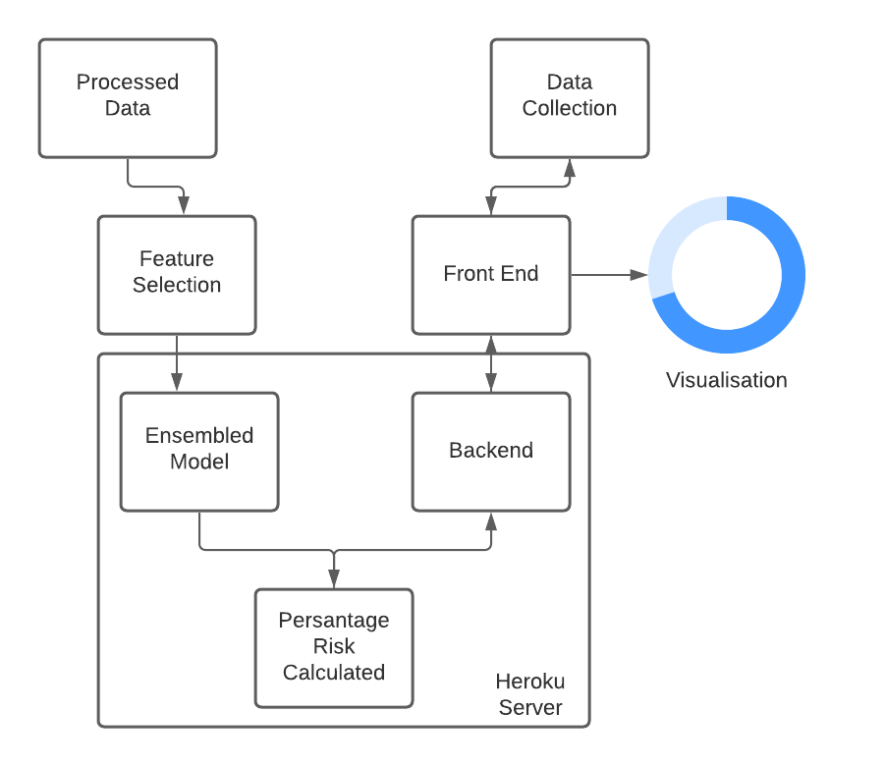
BLOCK DIAGRAM

Slide 10
TOOLS USED
Software Requirements:
Anaconda IDE
Python 3.7
Hardware Requirements:
Hard Disk: Greater than 500 GB
RAM: Greater than 4 GB
Processor: I3 Core and Above

Slide 11
ADVANTAGES
Early detection of Cancer will reduces the complication.
Reduction in significant amount of workload and time for ophthalmologists.
CNN-LSTM is able to generalize since they are trained by example.

Slide 12
DISADVANTAGES
Limitation in choosing the size of image
Costly implementation

Slide 13
MODULES
Data Collection
Dataset
Data Preparation
Model Selection
Analyze and Prediction
Accuracy on test set
Saving the Trained Model

Slide 14
Data Collection:
This is the first real step towards the real development of a machine learning model, collecting data. This is a critical step that will cascade in how good the model will be, the more and better data that we get, the better our model will perform.
There are several techniques to collect the data, like web scraping, manual interventions and etc.
Breast Cancer dataset taken from kaggle and some other source

Slide 15
Data Preparation:
we will transform the data. By getting rid of missing data and removing some columns. First we will create a list of column names that we want to keep or retain.
Next we drop or remove all columns except for the columns that we want to retain.
Finally we drop or remove the rows that have missing values from the data set.

Slide 16
Model Selection:
While creating a machine learning model, we need two dataset, one for training and other for testing. But now we have only one. So lets split this in two with a ratio of 80:20. We will also divide the dataframe into feature column and label column.
Here we imported train_test_split function of sklearn. Then use it to split the dataset. Also, test_size = 0.2, it makes the split with 80% as train dataset and 20% as test dataset.
The random_state parameter seeds random number generator that helps to split the dataset.
The function returns four datasets. Labelled them as train_x, train_y, test_x, test_y. If we see shape of this datasets we can see the split of dataset.

Slide 17
Model Selection:
We will use LSTM+CNN Classifier, which fits multiple decision to the data. Finally I train the model by passing train_x, train_y to the fit method.
Once the model is trained, we need to Test the model. For that we will pass test_x to the predict method.
LSTM+CNN is one of the most powerful methods that is used in machine learning for regression problems. The CNN comes in the category of the supervised regressor algorithm. This algorithm is carried out in two different stages the first one deals with the creation of the forest of the given dataset, and the other one deals with the prediction from the regressor.

Slide 18
Analyze and Prediction Module
In the actual dataset, we chose only 3 features :
PPG
Sample
Phg Features
Accuracy on test set:
We got a accuracy of 98.1%,97.1% on test set.

Slide 19
Conclusion
The objective of our study is to investigate a good method for automated analysis of breast images for the purpose of detecting and recognizing Cancer diseases.
The proposed method can recognize with Cancer accurately, in comparison to other methods and is potentially a powerful tool for the recognition of Cancer diseases.

Slide 20
Thank you

